Slide 1
Orbit Analysis for Satellite coverage
Kevin Liu

Slide 2
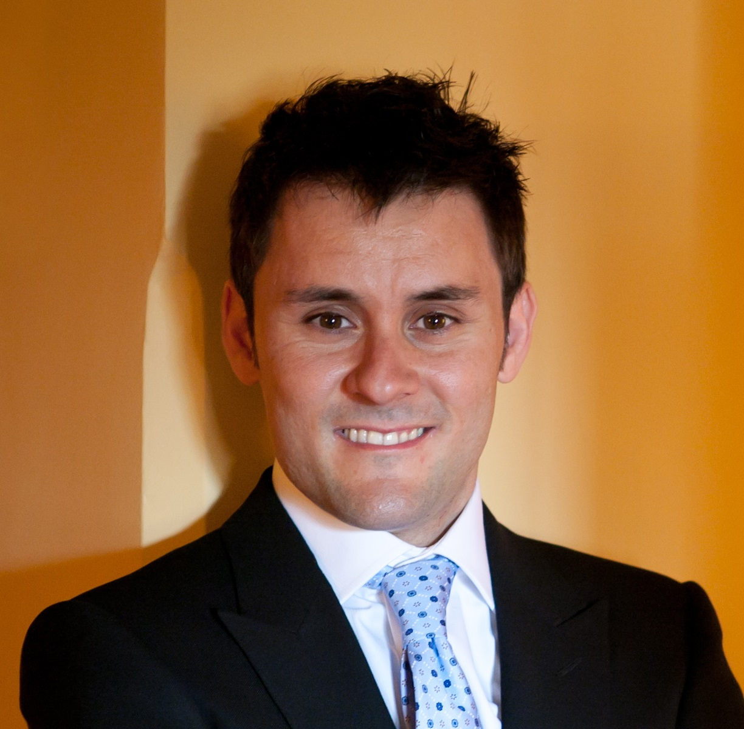
About the Lab
Systems Engineering, Architecture, and Knowledge (SEAK) Lab
Professor Daniel Selva (MAE)

Slide 3
Project Overview
Automated Satellite Design
Power
Thermal
Avionics
Structures
ADCS
Comms
Question is: What is the best/cheapest configuration of a satellite in order to satisfy mission requirements and accomplish the goal of the mission?

Slide 4
My Part of the Project
Responsible for providing information to other subsystems about Orbit
Period
Velocity
Eclipse Times
Coverage

Slide 5
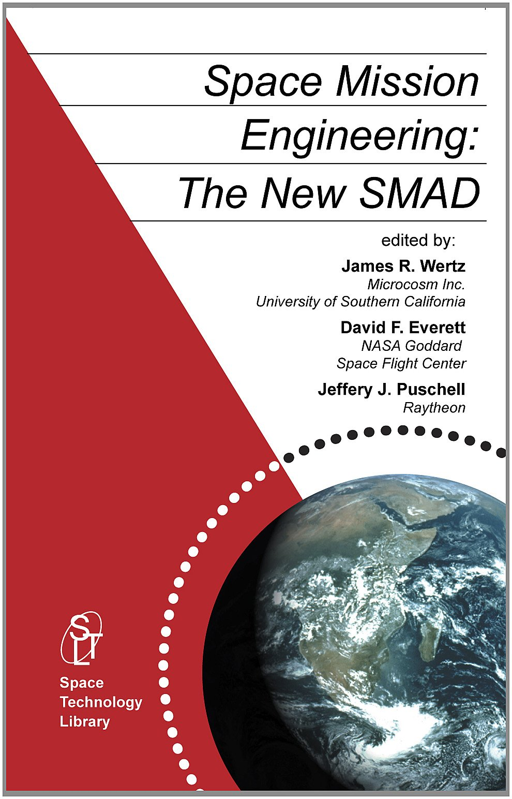
First Two Weeks
Learning about orbit properties
Wrote MATLAB object “Orbit” which created an orbit object, and could return properties
Period
Velocity
Elapsed time to go from one point to another
Coverage area
Ect.

Slide 6
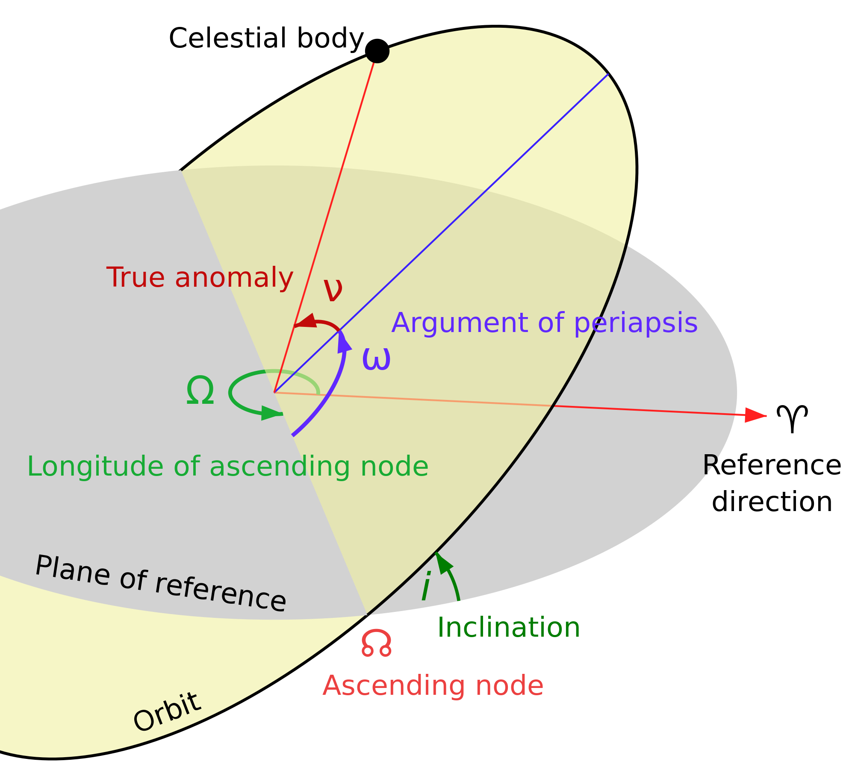
The Classic Elements
Any orbit can be defined by 6 parameters called the “Classic Elements”
a: semimajor axis (km)
e: eccentricity
i: inclination (deg)
Ω: right ascension of ascending node (deg)
ω: argument of perigee (deg)
ν: true anomaly (deg)

Slide 7
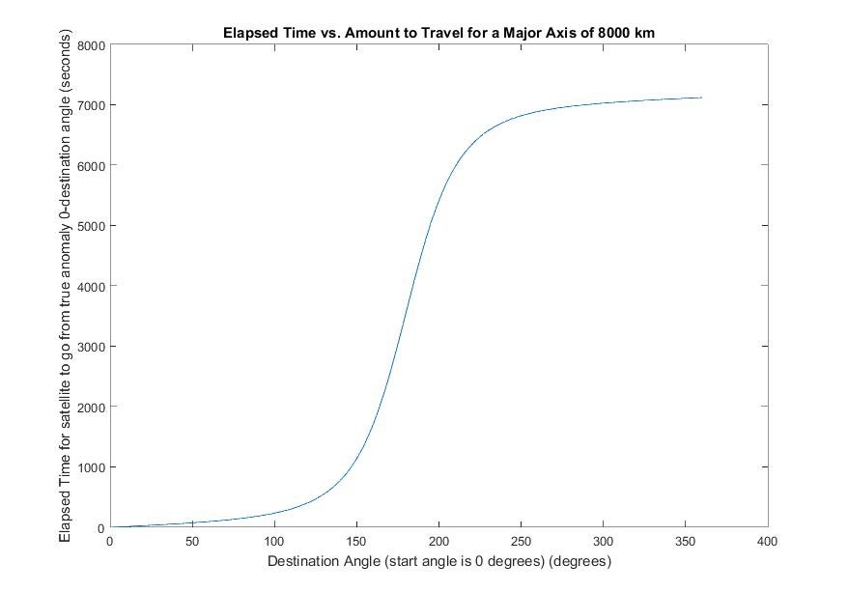
Example Plot from Orbit object

Slide 8
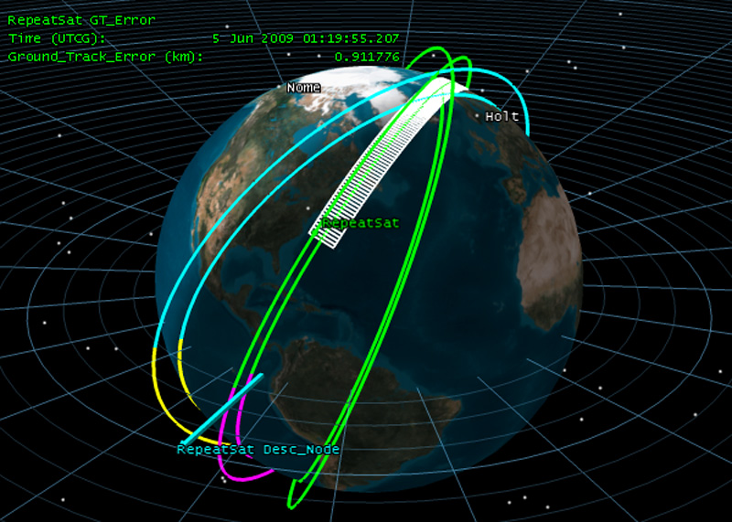
Weeks 3-4
Learning to use Systems Tool Kit
Getting STK Certified
Returning relevant Orbit statistics
Average Revisit Time
Max Revisit Time

Slide 9
Weeks 5-7
Creating Coverage Grid for whole planet
Automating simulations with MATLAB
Retrieving and storing simulation results
Making plots and analyzing data

Slide 10
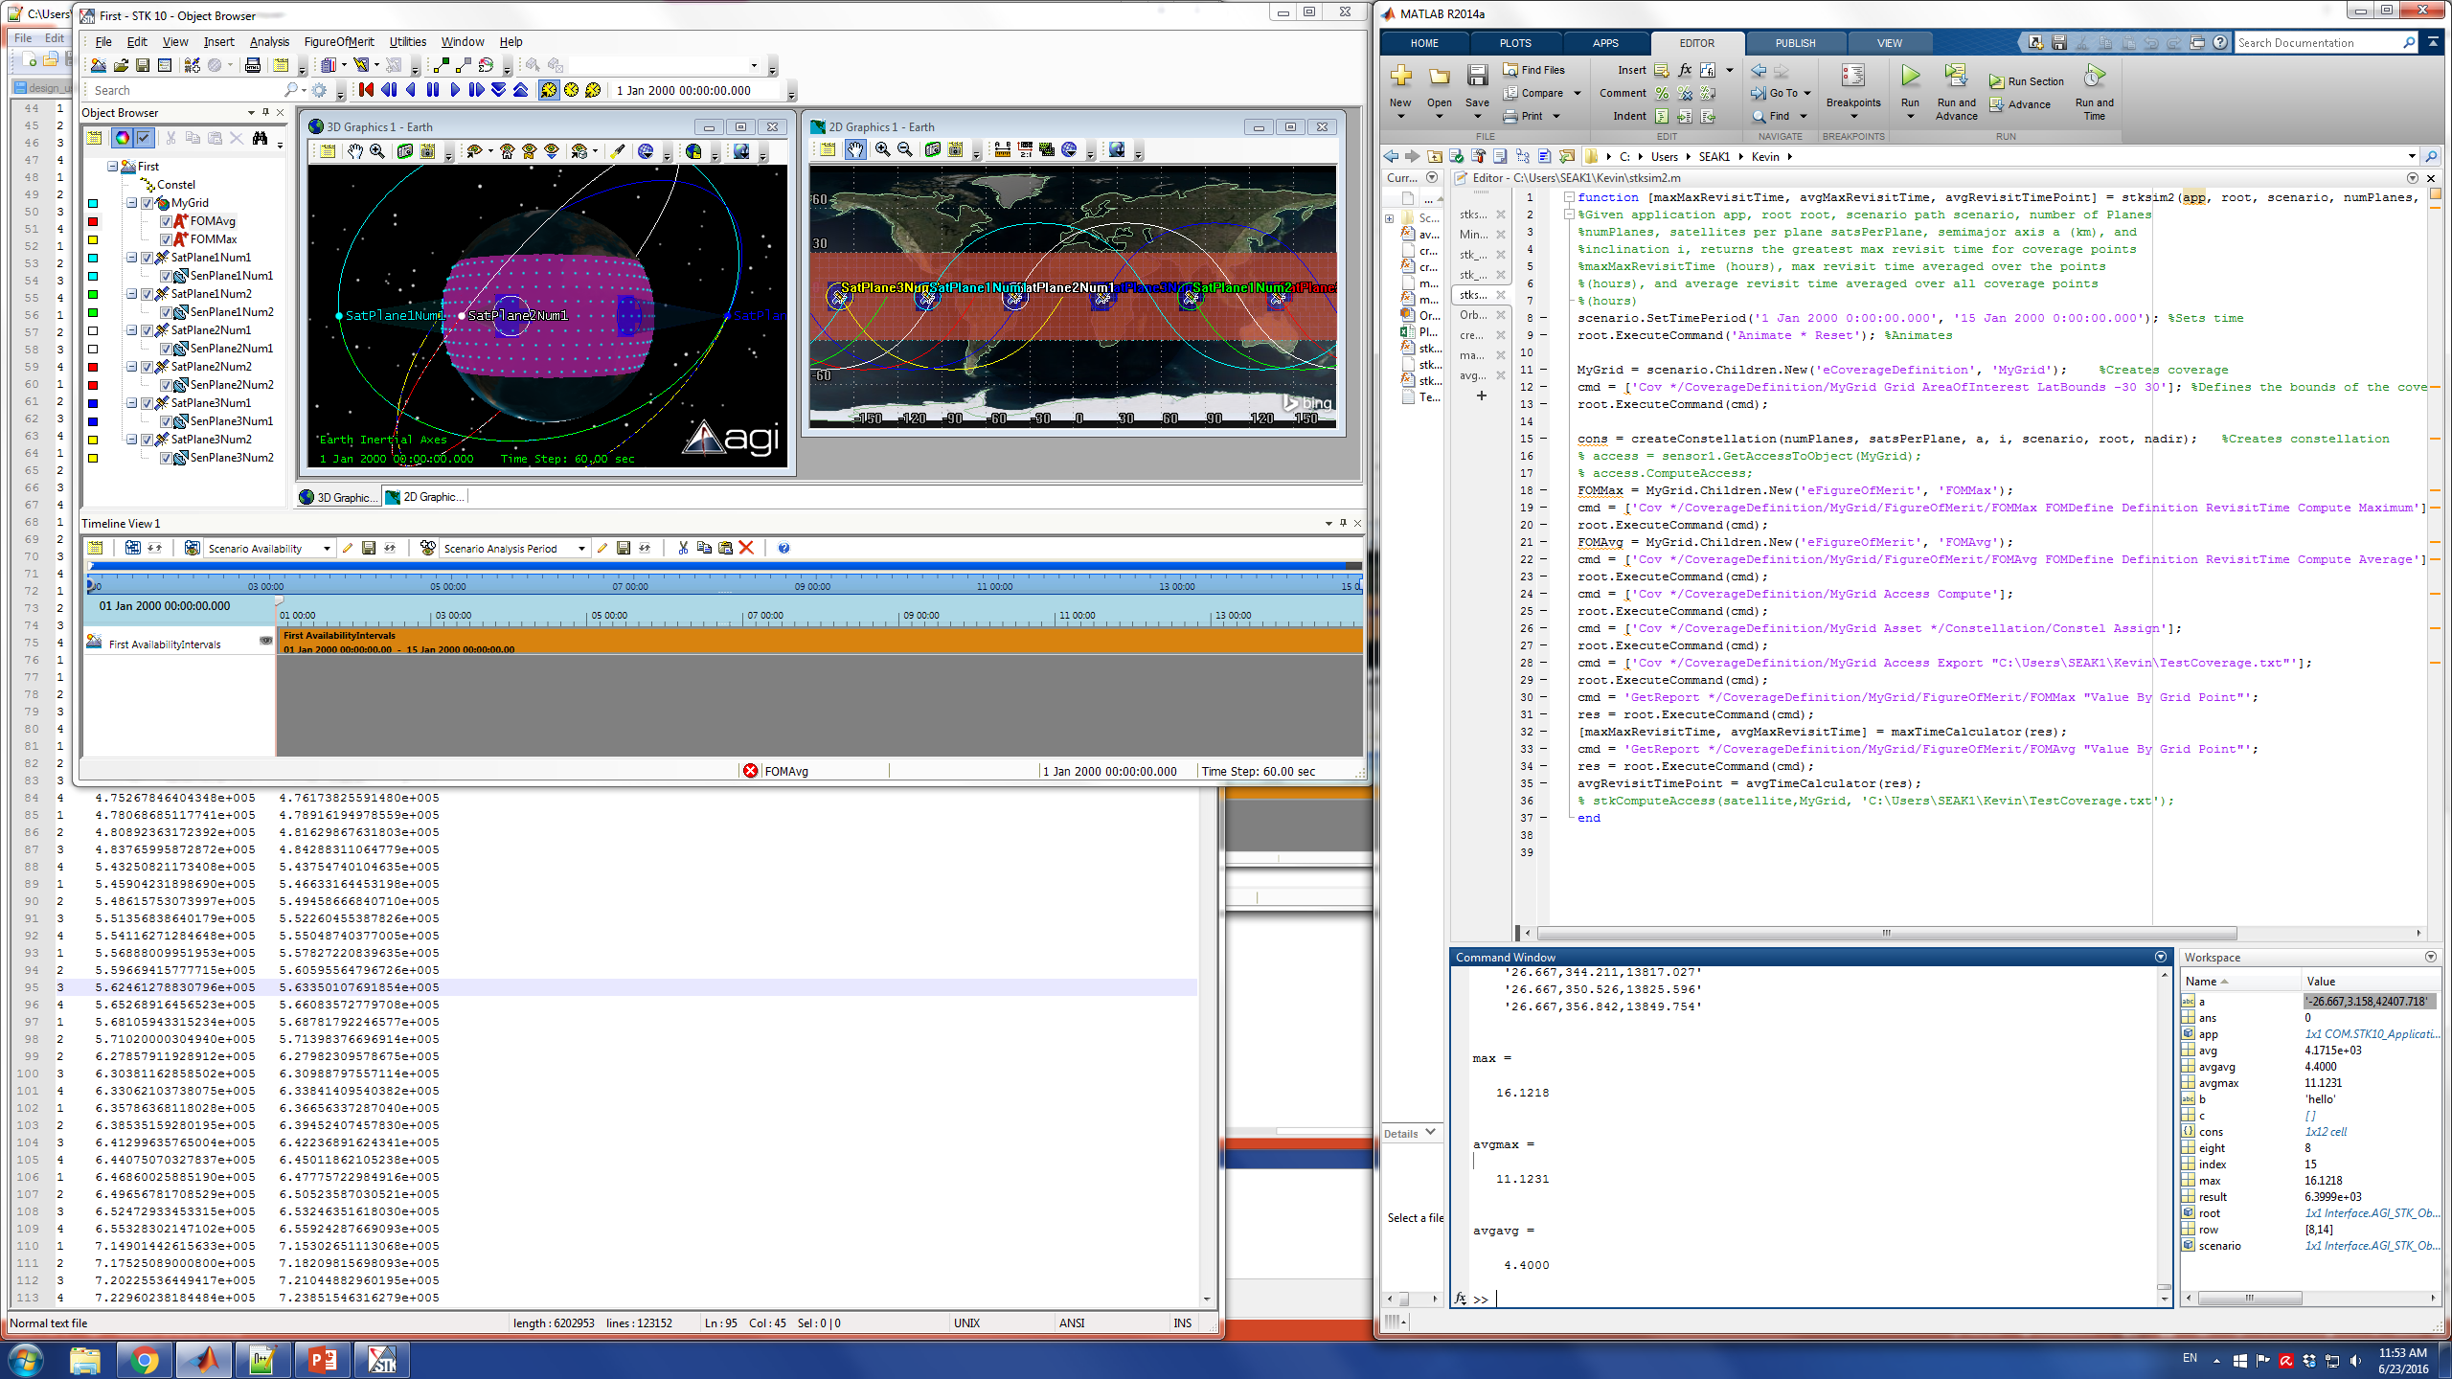

Slide 12
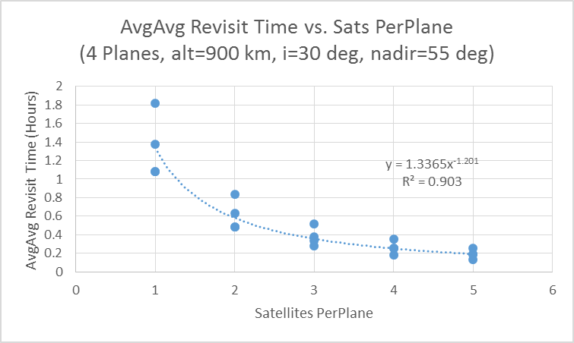

Slide 13
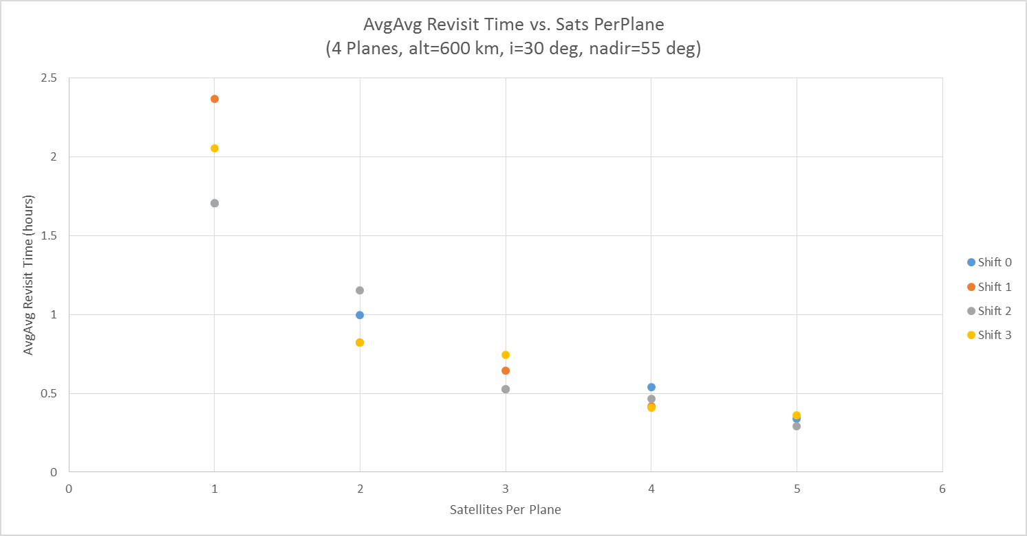

Slide 14

Week 8
Switching from STK to Orekit

Slide 15
STK vs. Orekit
STK Keplerian
Orekit Kepler
Access Start Time (UTCG) Stop Time (UTCG) Duration (sec)
------ ----------------------- ----------------------- --------------
1 2 Jan 2004 14:03:14.556 2 Jan 2004 14:07:45.583 271.028
2 3 Jan 2004 01:55:03.930 3 Jan 2004 01:57:54.617 170.687
3 3 Jan 2004 14:11:25.499 3 Jan 2004 14:15:28.396 242.898
4 4 Jan 2004 02:02:25.824 4 Jan 2004 02:06:28.186 242.362
5 4 Jan 2004 14:19:58.682 4 Jan 2004 14:22:50.655 171.973
6 5 Jan 2004 02:10:08.459 5 Jan 2004 02:14:39.329 270.870
7 6 Jan 2004 02:18:04.408 6 Jan 2004 02:22:35.411 271.003
8 7 Jan 2004 02:26:13.293 7 Jan 2004 02:30:16.735 243.442
9 7 Jan 2004 13:08:27.250 7 Jan 2004 13:11:18.713 171.463
10 8 Jan 2004 02:34:41.056 8 Jan 2004 02:37:37.274 176.217
11 8 Jan 2004 13:15:46.401 8 Jan 2004 13:19:47.773 241.372
Visibility on station1 begins at 2004-01-02T14:03:15.562
Visibility on station1 begins at 2004-01-03T01:55:03.964
Visibility on station1 begins at 2004-01-03T14:11:26.577
Visibility on station1 begins at 2004-01-04T02:02:25.606
Visibility on station1 begins at 2004-01-04T14:19:59.951
Visibility on station1 begins at 2004-01-05T02:10:08.144
Visibility on station1 begins at 2004-01-06T02:18:04.039
Visibility on station1 begins at 2004-01-07T02:26:12.891
Visibility on station1 begins at 2004-01-07T13:08:28.260
Visibility on station1 begins at 2004-01-08T02:34:40.632
Visibility on station1 begins at 2004-01-08T13:15:47.368
Final state : 604800.0

Slide 16
Orekit
STK HPOP (2 weeks)
Orekit EcksteinHechler (weeks)
Global Statistics
-----------------
Min Duration 11 7 Jan 2004 14:38:53.815 7 Jan 2004 14:39:48.686 54.871
Max Duration 23 15 Jan 2004 13:56:06.133 15 Jan 2004 14:00:39.686 273.552
Mean Duration 208.381
Total Duration 4792.765
Maximum revisit time: 273.66677839423215
Average revisit time: 208.4364210772713

